Slide 2
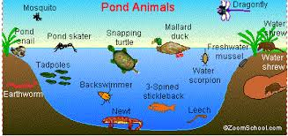
1. Pond Environment
Directions: Use the picture above to answer the questions below.
Name 3 biotic factor interacting with the 3 abiotic factors in this picture.
Name a biotic factor that is NOT interacting with an abiotic factor.
Name a population of organisms in the picture.

Slide 3
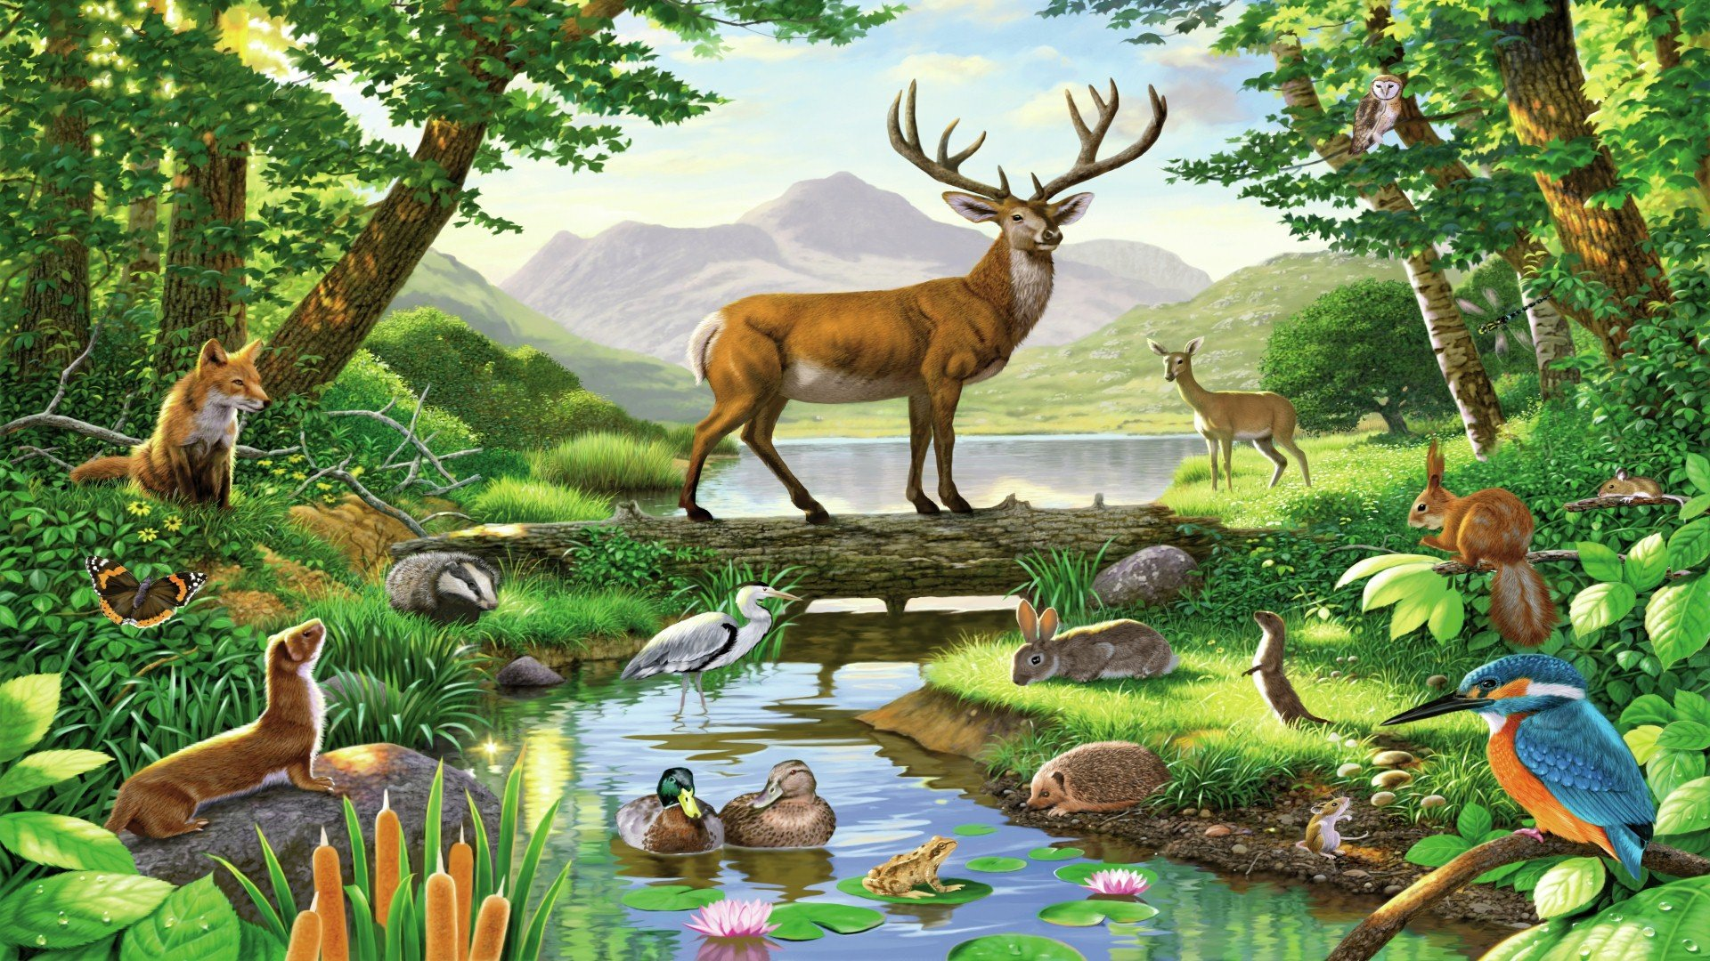
2. Forest Environment
Directions: Use the picture above to answer the questions below.
Name 3 biotic factors interacting with 3 abiotic factors in this picture.
Name an organism in the picture.
Define an ecosystem.

Slide 4
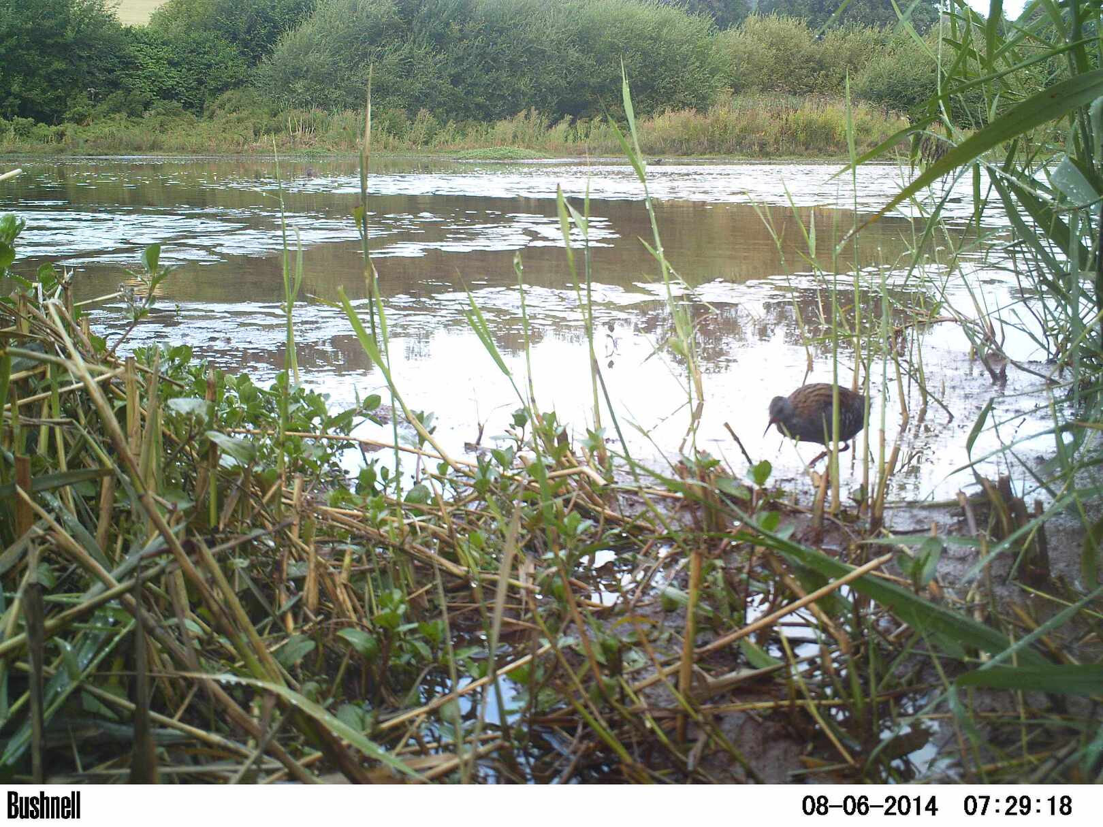
3. Marsh Environment
Directions: Use the picture above to answer the questions below.
Name 2 biotic factors interacting with 2 abiotic factors in this picture.
Name an organism in the picture.
What does the sun provide for the environment?

Slide 5
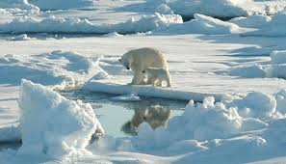
4. Artic Environment
Directions: Use the picture above to answer the questions below.
Name one biotic factor interacting with one abiotic factor in this picture.

