Slide 1
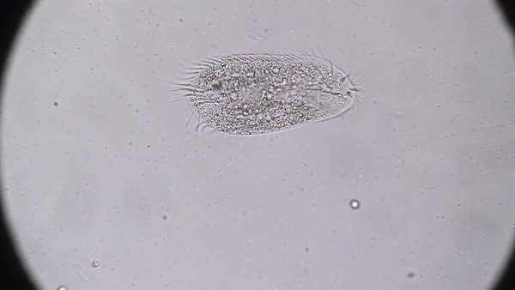
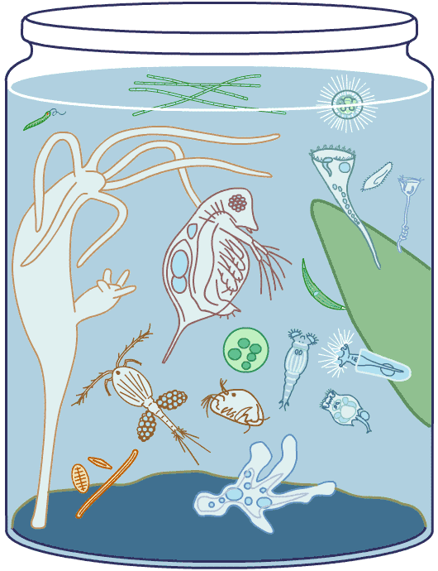
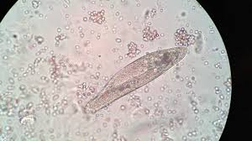
Pond Water
Pond Water seen under a microscope.
.

Slide 2
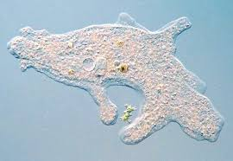
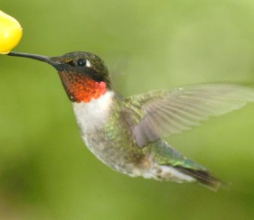
Your Objective
1. You will understand that organisms are composed of one or more cells.
2. You will identify the basic characteristics of organisms:
unicellular organisms
multicellular organisms
How will you achieve your objective?
You will read the powerpoint and complete a Venn Diagram.

Slide 3
Today’s Assignment
Today you will complete and turn in:
1. Complete a Venn diagram on your paper.
comparing and contrasting
unicellular and multicellular organisms
LOOK AT THE NEXT PAGE TO DRAW YOUR VENN DIAGRAM>

Slide 4

Today’s Assignment
Multicellular
Organism
Unicellular
Organism
BOTH
Define
Name 4 examples
Where are they found?
Draw pic
What do they have in common?
Define
Name 4 examples
Where are they found?
Draw pic

Slide 5
Background information
What does “micro” mean?
What is a microscope?
What is an organism?
What does “uni” mean?
What does “multi” mean?
What is a cell?

Slide 6
Micro
Something very small.
When referring to an organism, it can NOT be seen without a microscope.

Slide 7
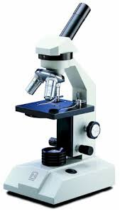
Microscope
What is a microscope?
is an instrument used to see
objects that are too small for
the naked eye.
What is an instrument?
In science, it refers to laboratory
equipment or tools in a laboratory used by
Scientists. This includes instruments
such as a microscope.

Slide 8
What is an Organism?
Definition:
  Organism – anything that can live on its own

Slide 9
Cells
What is a cell?
Cells are the basic building blocks of all living things.
For example, the human body is composed of trillions of cells.
They provide structure for the body, take in nutrients from food, convert those nutrients into energy, and carry out specialized functions.

Slide 10
Unicellular
Organisms

Slide 11
Unicellular Organisms
Definition:
  Unicellular organism – an organism made of only one cell
  Uni – means “one”.
Information:
  These organism are very small and need to be seen with a microscope.
  These organisms CANNOT be seen with the naked eye.
  Some are found on materials and surface areas.
  Others are found in water.

Slide 12
Unicellular:
Common Names
Microscopic Organisms
Microorganisms
Really small living things

Slide 13
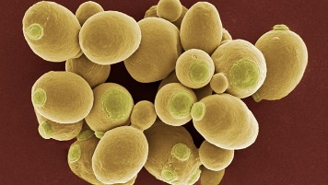
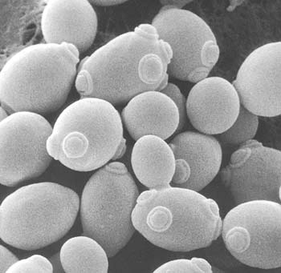
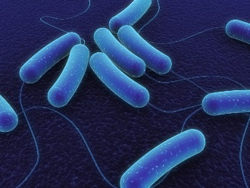
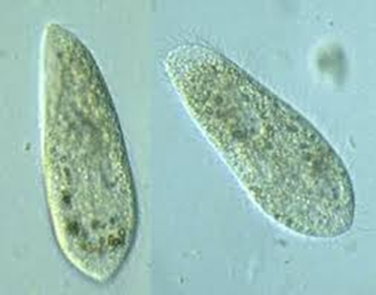
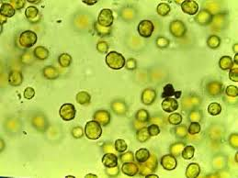
Examples of
Unicellular Organisms
Amoeba
Bacteria
Unicellular algae
Unicellular fungi
Unicellular yeasts
Paramecium

Slide 14
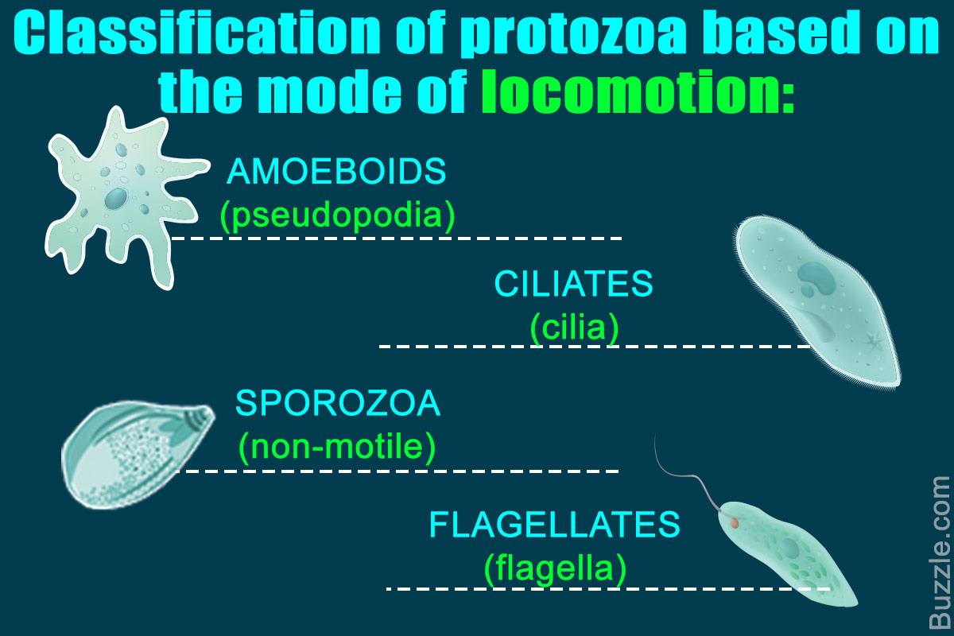
Unicellular Organisms
Ways that protozoa move:

Slide 15
Multicellular
Organisms

Slide 16
Multicellular Organisms
Definition:
  Multicellular organism – an organism made of two or more cells
Information:
  These organisms are able to be seen with the naked eye (without a microscope).
  These organisms need all parts of itself to survive.
  We are multicellular organisms.

Slide 17
Common Names
Many – celled organisms
Eukaryotic organisms
Mammals
Birds
Reptile
Fish
Many others…
If you can SEE an organism, it is multicellular

Slide 18
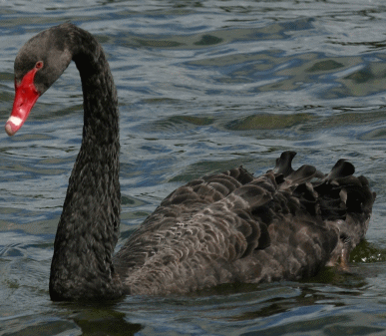
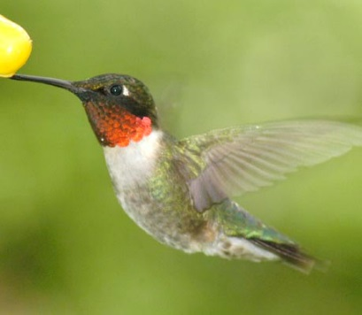
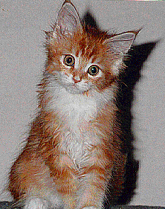


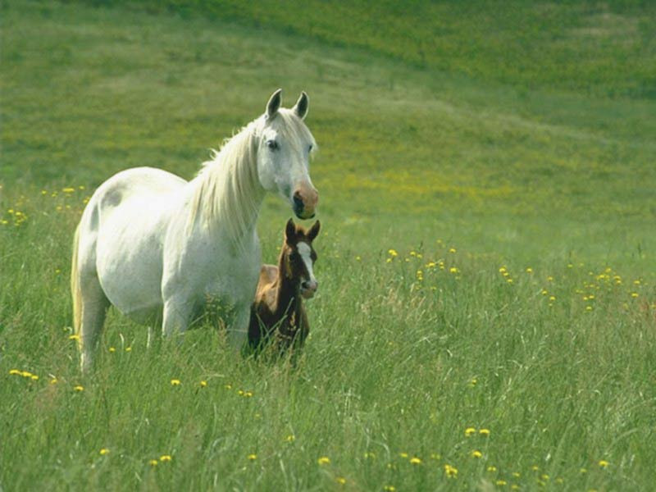
Examples of Multicellular Organisms
Humans
Cats
Dogs
Insects
Birds
Flowers
Mold
Trees

Slide 19
Review Questions: (Answer on the next page)
1. What type of organism is a hamster?
Multicellular
Unicellular
Both

Slide 20
Review Questions: Answer
1. What type of organism is a hamster?
Multicellular

Slide 21
Review Questions (answers on the next page)
2. What is a unicellular organism?
a. An organism that has only one cell.
An organism that requires a microscope to view it.
An amoeba is unicellular.
All of the above.

Slide 22
Review Questions: Answer
2. What is a unicellular organism?
d. All of the above.

Slide 23
Additional Interesting Information Compare/Contrast
Unicellular Organisms – (one celled) organisms are good models for membrane transport, because they need to perform MANY functions with one cell, rather than many types of cells.
Multicellular organisms- organisms that consist of more than one cell, in contrast to single-celled organisms. To form a multicellular organism, these cells need to identify and attach to the other cells.

